Slide 1
Past Simple and Past Continuous
Grammar 1

Slide 2
Past Simple - form

Slide 3
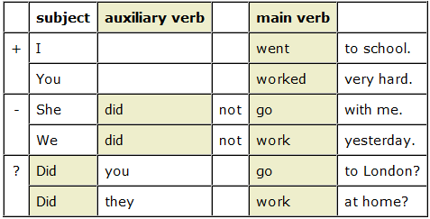
Form

Slide 4
Pronunciation

Slide 5
Use
For an action which happened at a definite time in the past. The time is stated / known / implied.
They went camping last month.
They were there 1 year ago. Every day they went swimming and walking. One day they saw something strange...
We use it for single completed actions and states.
Julius Caesar invaded Britain in 55 BC.
Holland was occupied by the Germans in 1940.

Slide 6
For actions happening immediately one after another:
First she paid the driver, then she got out of the taxi.
I got up, switched off the radio, and sat down again.
For repeated actions in the past:
My brother applied for a visa six times.

Slide 7
For habits or states which are now finished. We can also use used to:
Kitchens used to be very different 100 years ago.
Every day I went to the park.
Would can used to describe repeated actions, not states. It
describes a habitual activity which was typical of a person.
- Every week he would buy his mother flowers.
Used to would also be possible here. Compare:
- I used to like cowboy films. (Would is not possible here.)
We use the past simple to describe states in the past:
We lived just outside Oxford in the nineties, but we didn't have a car.
In those days, I didn't like reading.

Slide 8
Time expressions

Slide 9
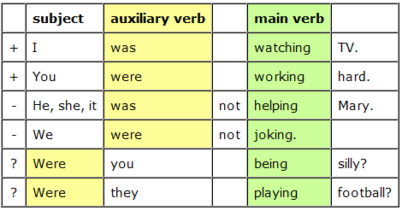
Past Continuous

Slide 10
Use
For an action in progress at a stated time in the past.
At 7 pm yesterday we were having lunch.
This time last week we were swimming.

Slide 11
- While I was opening the window, the phone rang.

Slide 12
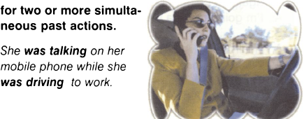

Slide 13
I entered the office and looked around. Most people were working at their desks, but Jane was staring out of the window and pretending to write something at the same time.

Slide 14
For changing and developing states:
- The car was getting worse all the time. One of the headlights was gradually falling off, and the engine was making more and more funny noises.
- His symptoms were becoming more pronounced each day. (a changing situation)
We often use the past continuous to show that a past action was temporary:
- During my training I was earning a lot less than my wife. (a temporary situation)

Slide 15
These describe events intended to take place, but which did not happen.
- I was going to phone you, but I forgot.
- I was thinking of going to Italy this year, but I haven't decided.
• The contrasting past event is often understood, but not stated.
- How are you? I was going to phone you ... (but I didn't).

Slide 16
To be polite. These are common with wonder.
- I was wondering if you wanted to come to the cinema.
- Were you planning on going somewhere else later? (= Are you planning on ... ?)
For criticism:
- When Jane was at school, she was always losing things.

Slide 17
We usually use the past simple for repeated actions in the past, but we can use the past continuous if we want to emphasise that the repeated actions took place over a temporary and limited period of finished time:
- She received therapy on a weekly basis. (a repeated action)
- For the first three months she was receiving therapy on a weekly basis.
(repeated action, but only for three months)

